Slide 1
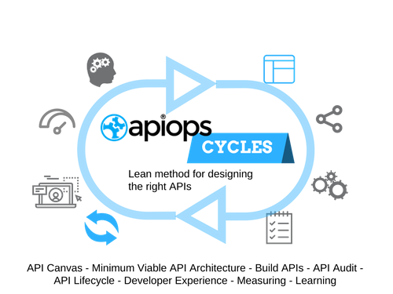
 | ”name”: ”APIOps® Cycles Design Book”, ”description": ”APIOps® Cycles is a Lean Method for Designing and Managing API Products",
 | ”audience”: [”Business Developers”, ”Product Managers”, ”Architects”, ”Developers”, ”Integration specialists”],
 | ”version": ”2.0"

Slide 2
Overview
What is APIOps® Cycles?
I want to know more!
The APIOps© Cycles is a set of tools and methods originally created by Digia. The tools and methods are designed to help all organizations and individuals to build great APIs.
APIOps©Cycles method uses a re-interpreted version of an API Canvas. We have added our experience to the model which is a form of popular business model canvas.
You can learn and adapt the method to your API needs either on your own or with API consultants.
The APIOps© Cycles method uses modern and proven frameworks with a twist of our experience to fit them for APIs. All methods have a Lean management base: Business Model Canvas, Value Proposition Canvas, Lean Startup, Minimum Viable Architecture and DevOps .
The method fits also in an organization where the working methods are not yet very lean or agile. Or at least there is a clear separation of development and operations. The main benefit of the methods is that they enforce communication. APIOps© Cycles helps communication between different business roles and different IT roles.
First method is API Canvas, i.e. making sure we know what benefits come and to who for using the API. The Canvas helps to define the key features of the API. It also clarifies what we need to build to make the API real.
Read more about the method and find services, training and certifications at http://www.apiopscycles.com

Slide 3
Scanning realtime discussions
Realtime information of the customers and general public
Prevent scandals right on their root
Get source based information (F-book, twitter, reddit etc)
Get latest news related to the brand from the internet (Ready made API)
Burana?
Small brands dont get as much benefits
Not enough data
Trolls and spammers
Data privacy
No identified target group
Confusion of words (Apple)

Slide 12
Next stop: Minimum Viable API Architecture
More information at:
https://www.apiopscycles.com
Twitter: @apiopscycles

